Slide 1

Robotics

Slide 2
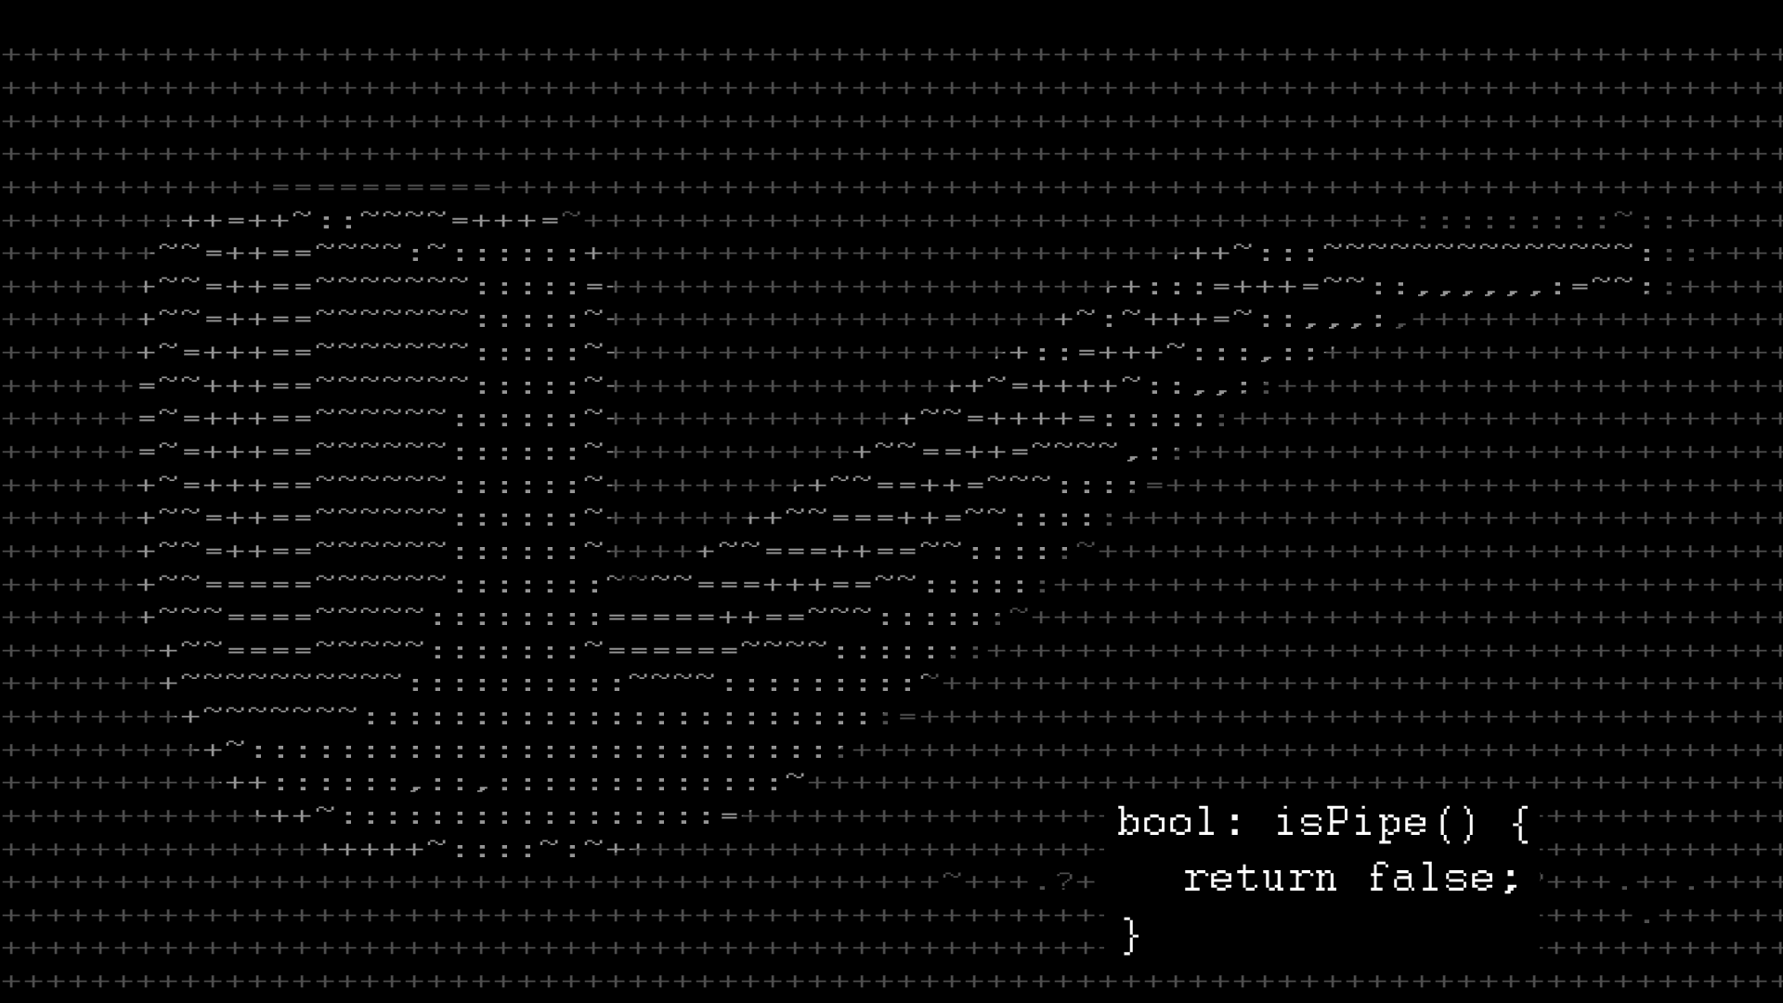
Arduino and programming
2
+
You don’t need anyone’s permission to create something
Chaitanya
Venkat

Slide 3
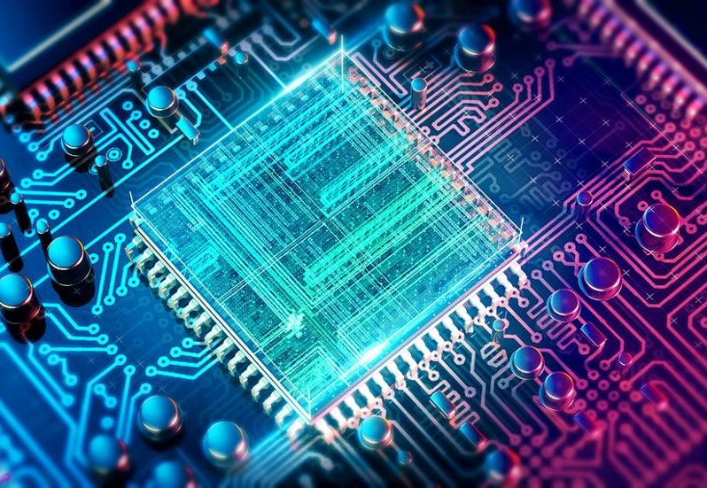


Embedded systems
2
+
2
+

Slide 4

What is an Embedded system?
An embedded system is one that has computer hardware with software embedded in it as one of its components.
We can define an embedded system as “A microprocessor based system that does not look like a computer”.
Or
We can say that it is “A combination of computer hardware and software, and perhaps additional mechanical or other parts, designed to perform a dedicated function. In some cases, embedded systems are part of a larger system or product, as is the case of an antilock braking system in a car ”.
An embedded system is a special-purpose computer system designed to perform certain dedicated functions. It is usually embedded as part of a complete device including hardware and mechanical parts.

Slide 5
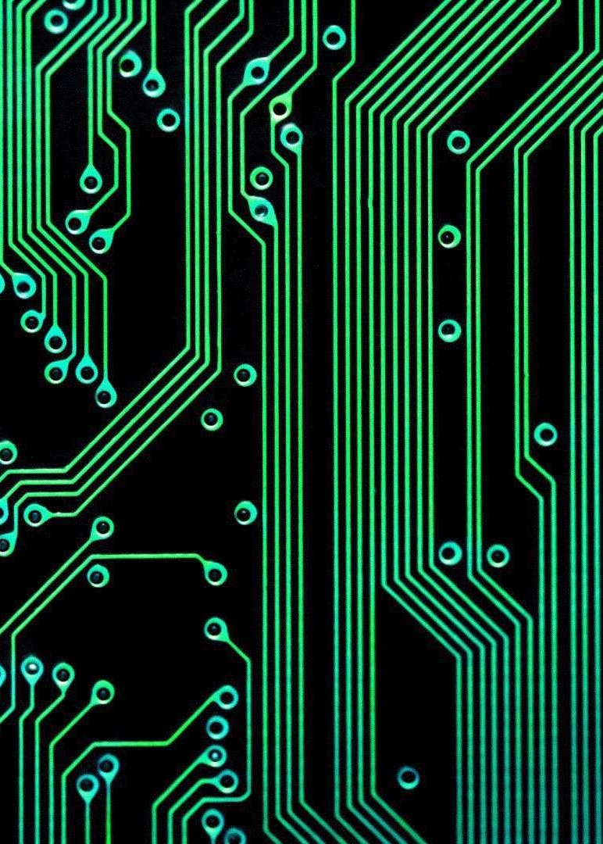
Significance and Usage
Due to their compact size, low cost and simple design aspects made embedded systems very popular and encroached into human lives and have become indispensable. They are found everywhere from kitchen ware to space craft. To emphasize this idea here are some illustrations
Biomedical Instrumentation
Communication Systems
Peripheral Controls of a computer
Industrial Applications
Scientific Instruments

Slide 6
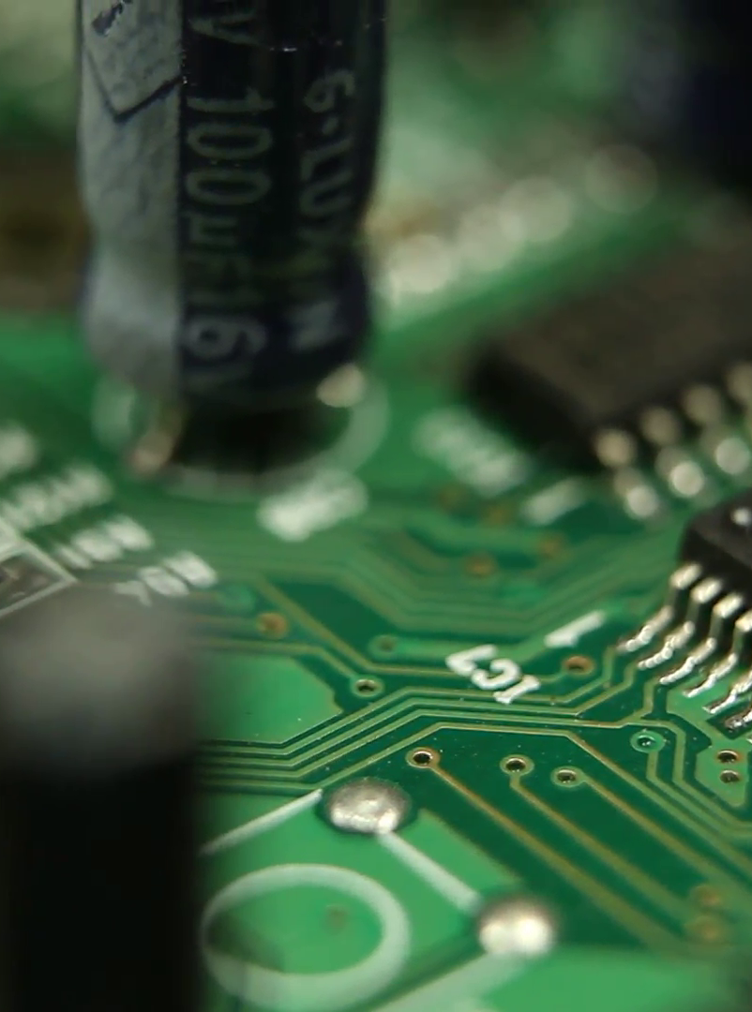
Microcontroller
A microcontroller is a small computer on a single integrated circuit. In modern terminology, it is similar to, but less sophisticated than, a system on a chip (SoC); an SoC may include a microcontroller as one of its components.
A microcontroller contains one or more CPUs (processor cores) along with memory and programmable input/output peripherals.
Program memory in the form of ferroelectric RAM, NOR flash or OTP ROM is also often included on chip, as well as a small amount of RAM.
Microcontrollers are designed for embedded applications, in contrast to the microprocessors used in personal computers or other general purpose applications consisting of various discrete chips.

Slide 7

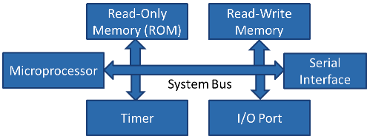
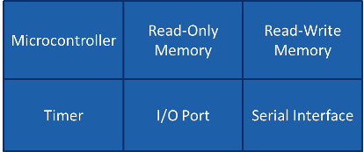
Microprocessor | Micro Controller
Microprocessor is heart of Computer system. | Micro Controller is a heart of embedded system.
It is just a processor. Memory and I/O components have to be connected externally | Micro controller has external processor along with internal memory and I/O components
Since memory and I/O has to be connected externally, the circuit becomes large. | Since memory and I/O are present internally, the circuit is small.
Cannot be used in compact systems and hence inefficient | Can be used in compact systems and hence it is an efficient technique
Cost of the entire system increases | Cost of the entire system is low
Due to external components, the entire power consumption is high. Hence it is not suitable to used with devices running on stored power like batteries. | Since external components are low, total power consumption is less and can be used with devices running on stored power like batteries.
Most of the microprocessors do not have power saving features. | Most of the micro controllers have power saving modes like idle mode and power saving mode. This helps to reduce power consumption even further.
Since memory and I/O components are all external, each instruction will need external operation, hence it is relatively slower. | Since components are internal, most of the operations are internal instruction, hence speed is fast.
Microprocessor have less number of registers, hence more operations are memory based. | Micro controller have more number of registers, hence the programs are easier to write.
Mainly used in personal computers | Used mainly in washing machine, MP3 players

Slide 8

arduino
2
+
2
+

Slide 9
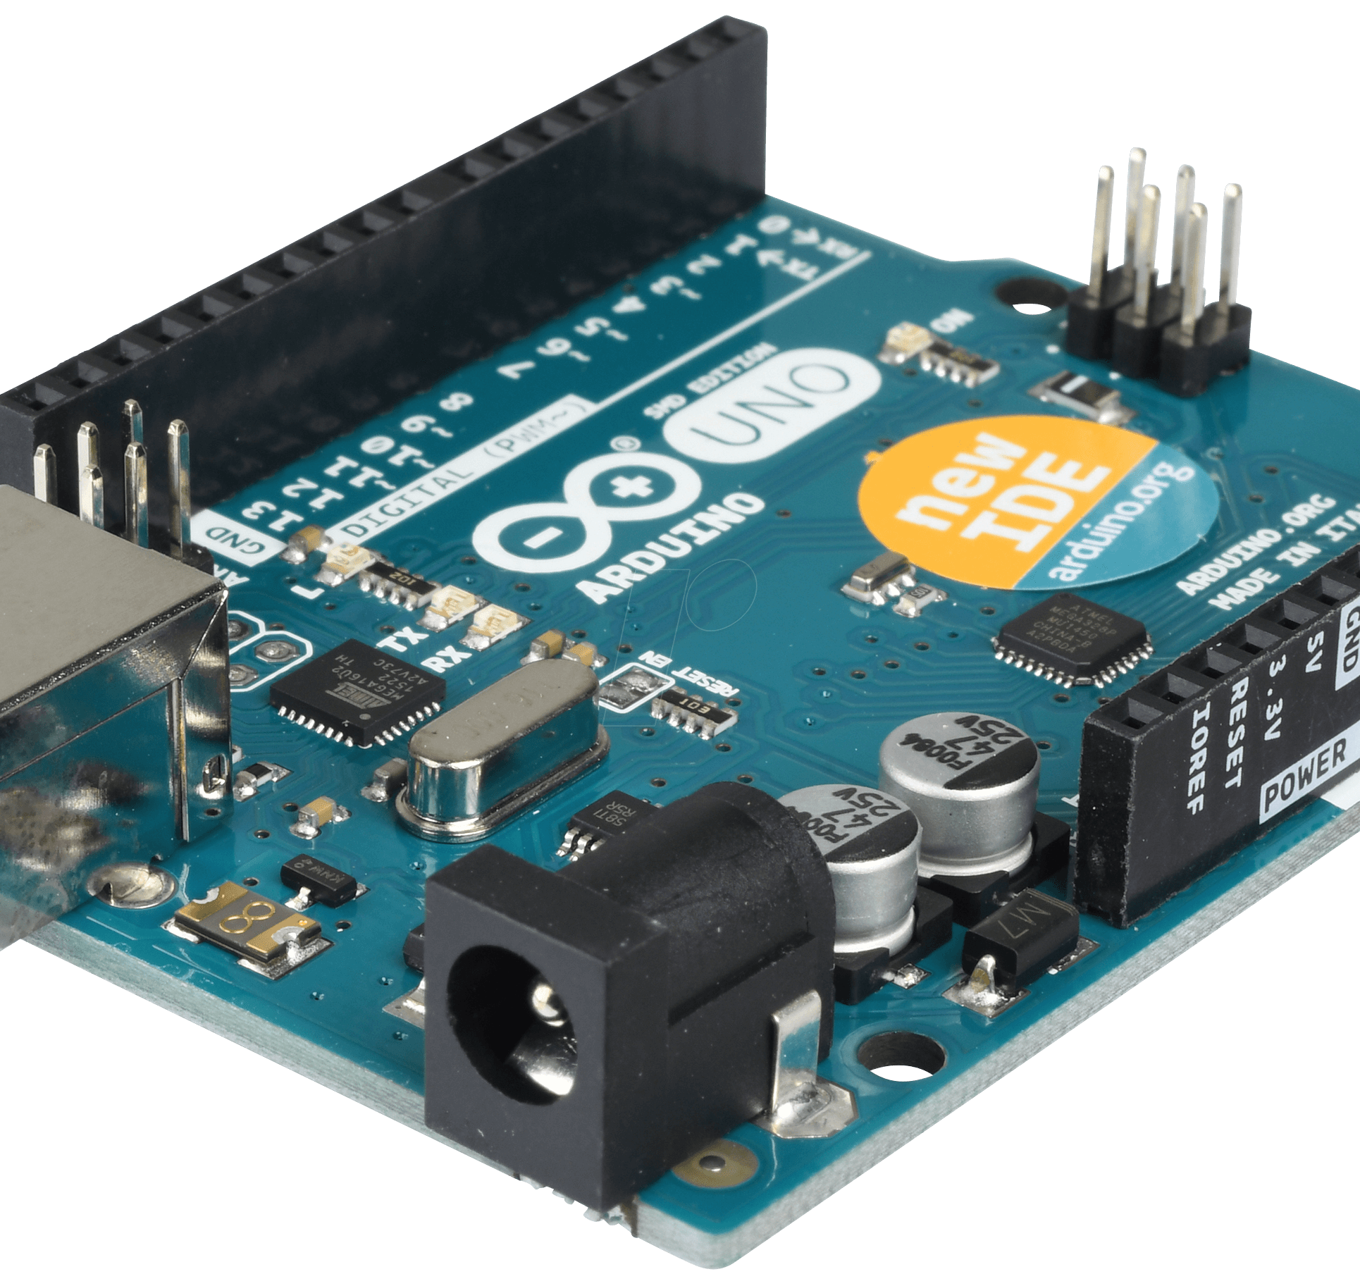
What is arduino?
2
+
Arduino is an open-source hardware and software company, project and user community that designs and manufactures single-board microcontrollers and microcontroller kits for building digital devices and interactive objects that can sense and control objects in the physical and digital world. Arduino technology is used to:
Develop: At universities it is widely adopted in the fields of engineering, Internet of Things, robotics, art, and design, to name just a few.
Teach and learn: Many secondary schools use it with innovative techniques for cross-curriculum studies.
Play: Primary schools use toys powered by Arduino technology to introduce physical learning, logic, building skills, and problem solving. Arduino’s Immersive Educational Environment promotes the creative process through project-based learning, with a focus on student interaction and group collaboration.

Slide 10
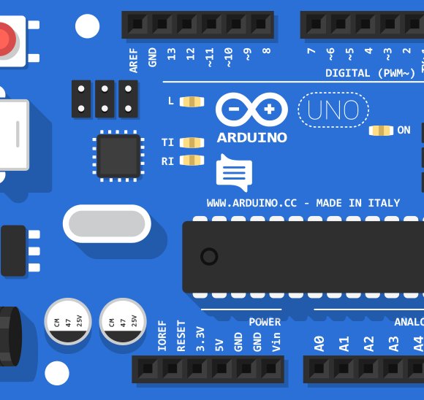
Why Arduino?
2
+
Debugging:-The Arduino Environment provide easiest debugging environment which is cross-platform and is accepted by every member of the family.
No programmer or dumping flash by dirty ways, With most of the companies already providing on-board debugger still compared to a lot of microcontroller(8051) upload is a click away.
Every time you don't need to take datasheet out and figure what the architecture is what are the addresses of the microcontroller to write simple functions like delay or interrupt.
Design of the board is very carefully crafted for beginners be it Moron Switch or ISP header to the polarity of power, The chances are steep that you would be blow it.
Peripherals and Modular Design: Arduino Ecosystem has fantastic modular design, you can simply add the already designed shields to the board with out any wire, just plug and play with peripherals like motor shield, Bluetooth shield,Wifi and what not already made.
Libraries: A lot of libraries and IC's have already been build for the same which is crucial a lot of times.

Slide 11


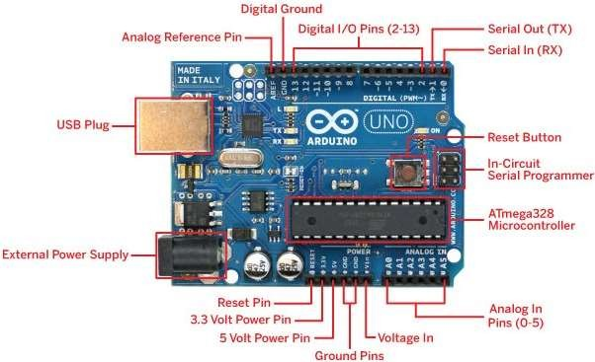
ARDUINO DEVELOPMENT BOARD
Eight bit microcontroller – brain of the board
USB Port – to communicate with the desktop/laptop
USB controller chip – manages USB transferred data
IO pins – board’s connection to the outside world
Quartz oscillator – board’s time keeper
Reset button – taking the board back to its initial state
External power jack – power from dedicated source Co-axial jack, but USB can also be used

Slide 12



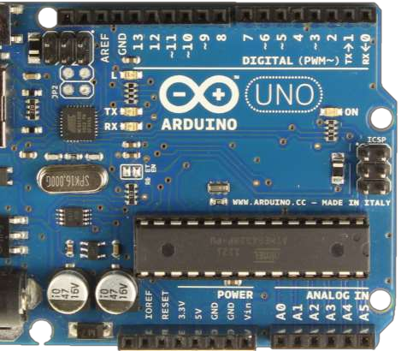
INPUT/OUTPUT PINS (I/O PINS)
Top and bottom rows of the board
Holes in the board which we can stick wires in
Holes are connected to the chips through traces on-board
14 Digital I/O pins on top [0-13]
Highs – 5 volts Lows – 0 volts Max Current - 40 mA
6 Analog input pins on the bottom [A0 – A5]
Power output pins on the bottom [ 5v , 3.3 v ]
Reset pin to reset the board to initial state

Slide 13
MICROCONTROLLERS
Two microcontrollers on the board
Main ATmega328 – 8 bit microcontroller
User programmable, runs user-written application code Carries firmware, like bootloader
ATmega16U2
Handles the communication with the USB interface, not
directly accessible

Slide 14
STORAGE & MEMORY
Non-volatile flash memory for storage
32 kilobytes in size
Static Random Access Memory (SRAM) for memory (volatile)
3 kilobytes in size

Slide 15
CLOCK
16 MHz clock speed ~ 16 million operations per second
Helps synchronize all components together
Keeping track of occurrence of events

Slide 16
PROGRAMMING FIRMWARE
The ISCP headers can be used to program the firmware on the board
ICSP1 for the main ATmega328 microcontroller
ICSP2 for the ATmega16U2 microcontroller
Special equipment are required in order to re-program the firmware through these headers

Slide 17

Sensors
Sensors are sophisticated devices that are frequently used to detect and respond to electrical or optical signals

Slide 18
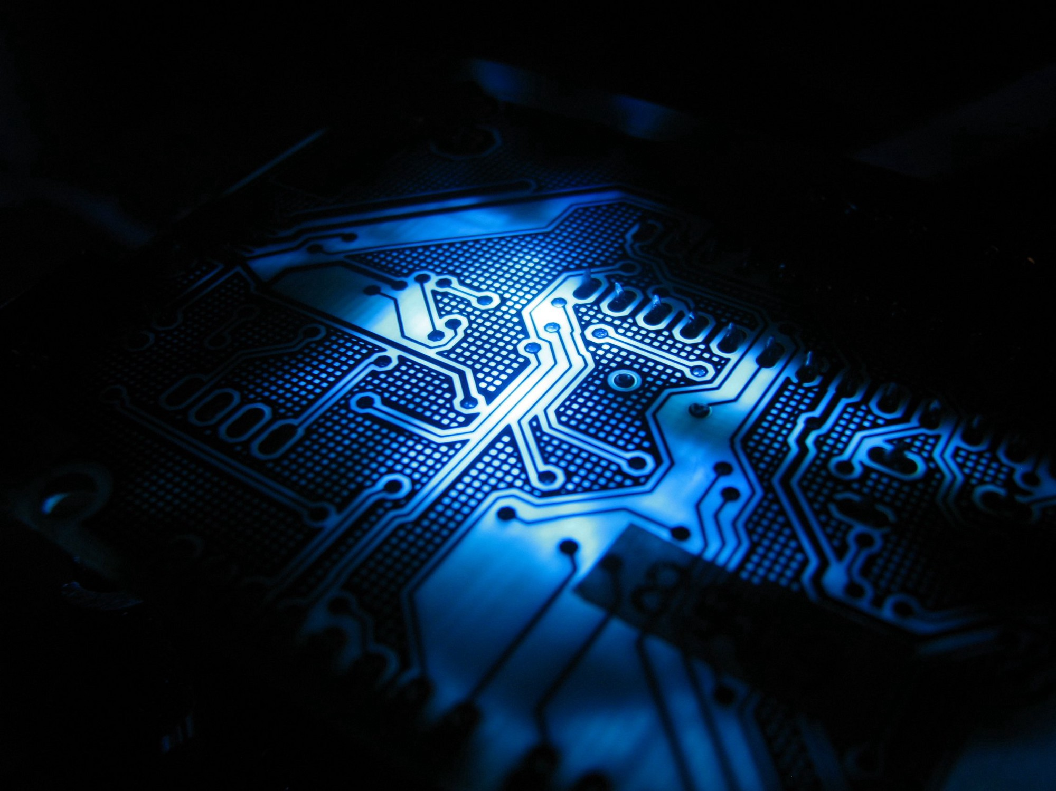
Sensors
Sensors can be both binary or a range.
Usually, sensors that measure a range of values vary their resistance to reflect their detection.
Arduinos can only sense voltages, not resistances.
Sensors that only vary their resistances require a circuit called a voltage divider to provide the Arduino a voltage.

Slide 19
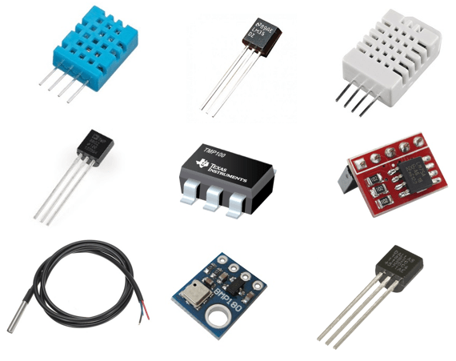
Common Sensors
Dials on a radio are simply potentiometers
Temperature
Light
Angle
Switches
did the user throw a switch or push a button?
Accelerometer (measures motion and tilt)
Infrared sensor & light
Hall effect sensor and magnet
Ball tilt sensor (for measuring orientation)
Force

Slide 20
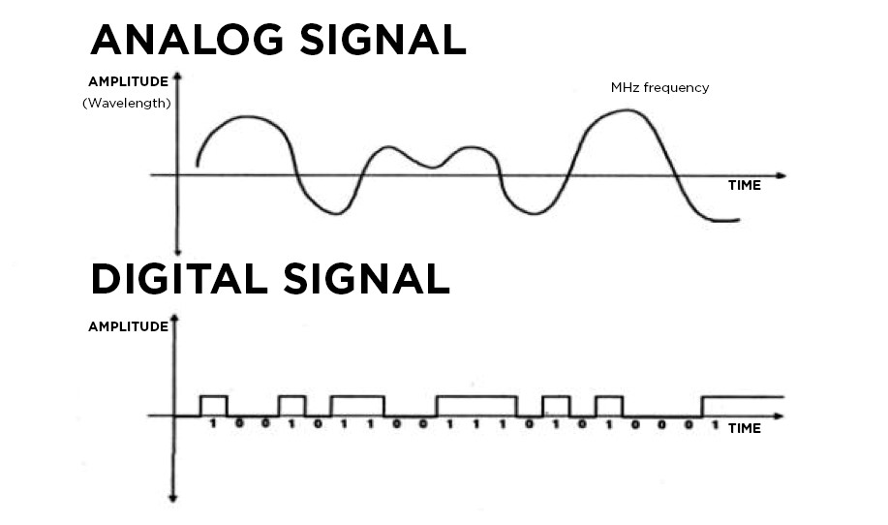
Sensors can be broken into two major categories:
Analog sensors
Based on changing the voltage of the sensor
Can only use analog inputs (A0, A1, etc.)
Generally easier to program and use
Not as accurate & easily interfered with by other electronics (noise in voltage)
Digital Sensors
Usually use digital pins
Can use more advanced forms of communication to let multiple sensors share the same pins (sometimes even using analog pins)
Generally more difficult to program and wire up; often need libraries and significantly more code for each type of sensor used
Most advanced sensors (GPS, IMU, etc.) are digital – this is the best way to pass more data between sensor and microcontroller quickly & efficiently

Slide 21
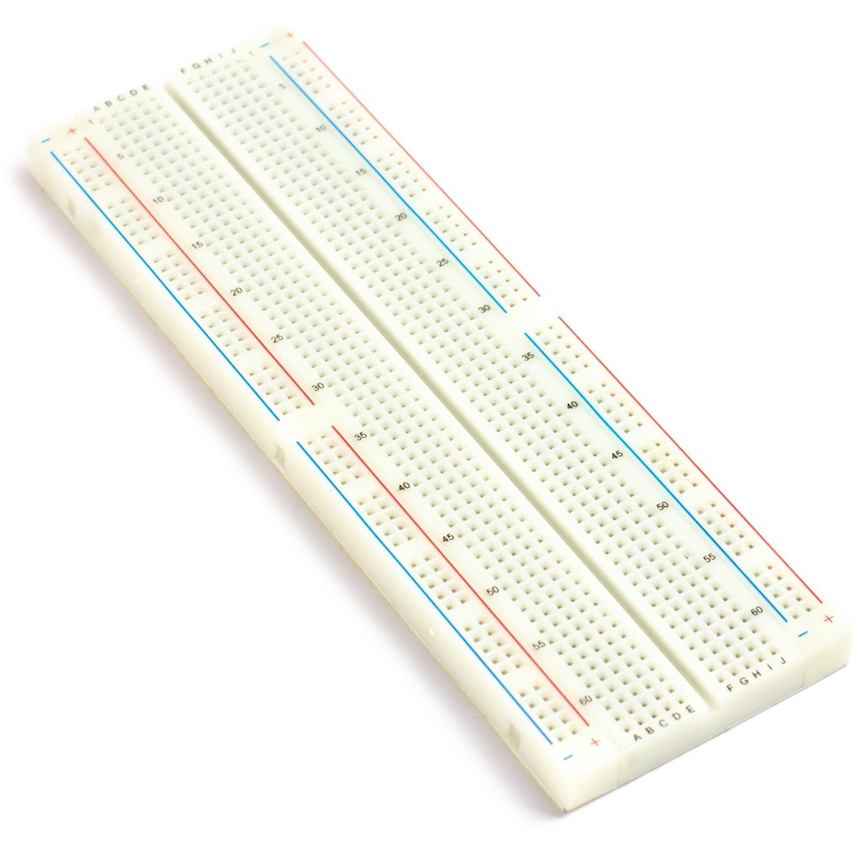
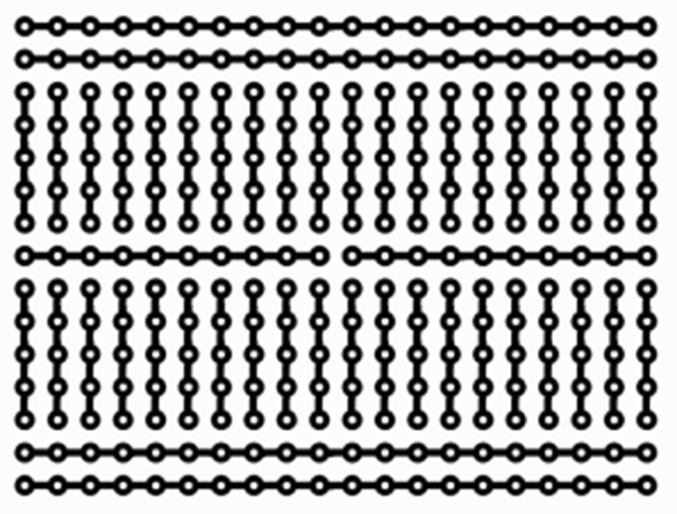
Breadboard
Breadboards are a simple and useful way to quickly assemble and play around with different circuits.
Building circuits with a breadboard is as simple as sticking wires and components into the holes. The holes themselves are connected according to the diagram.

Slide 22
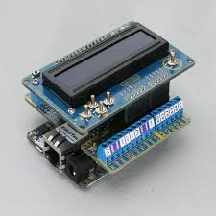
Shields
Shields are boards that can be plugged on top of the Arduino PCB extending its capabilities. The different shields follow the same philosophy as the original toolkit: they are easy to mount, and cheap to produce.
Arduino shields are boards that will expand the functionalities of your Arduino. You just need to plug them over the top of the Arduino board. There are countless types of shields to do countless tasks.

Slide 23

2
+
Integrated Development Environment(IDE)

Slide 24
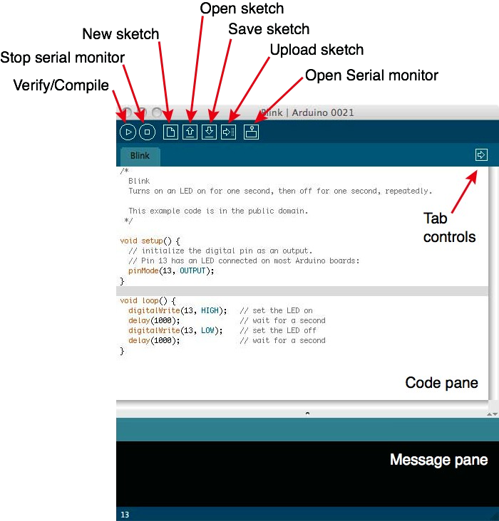
Arduino IDE

Slide 25
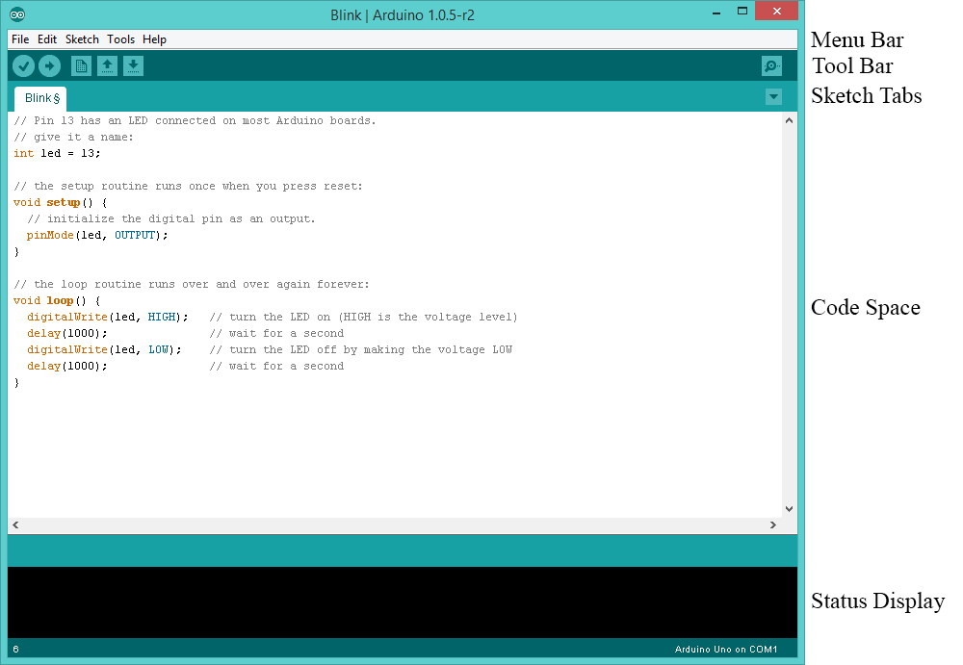

Slide 26
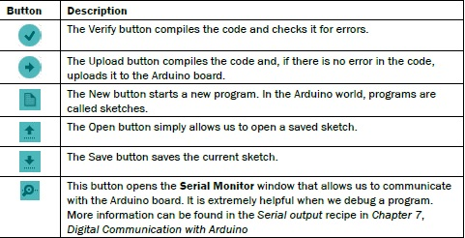
Toolbar

Slide 27
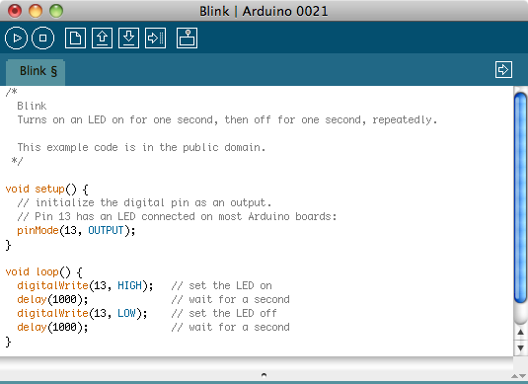
Code Structure: Header
Header provides Information

Slide 28
Code Structure: setup function
Setup is only executed once in the beginning

Slide 29
Code Structure: loop function
 | loop function is
 |  | repeated indefinitely

